Slide 1
Software Design

Slide 2
Software Design
Noun :
  Represents the abstract entity -design- of a system
  Design of an existing system
  Every existing system has a design
  Design of a system to be constructed
  Design is a plan for a solution
Verb :
  The process of design(ing), which results in a design
  Resulting design is a plan for a solution

Slide 3
Design…
Design activity begins with a set of requirements
Design done before the system is implemented
Design is the intermediate language between requirements and code
Moving from problem domain to solution domain
Proceeding from abstract to more concrete representations
Result is the design to be used for implementing the system

Slide 4
Design…
Design is a creative activity
Goal: to create a plan to satisfy requirements
Perhaps the most critical activity during system development
Design determines the major characteristics of a system
Has great impact on testing and maintenance
Design document forms reference for later phases

Slide 5
Design Process
How requirements are realized.
& how software designs are documented.
Aim is to find a solution to problem given in SRS document.

Slide 6
Levels in Design Process
Architectural design
  Identifies the components needed for the system, their behavior, and relationships
High Level Design
  Really is the module view of the system
  I.e. what modules are in the system and how they are organized

Slide 7
Levels..
Logic design
  Components and modules are designed to satisfy their specs
  How to implement components
  Algorithms for implementing component are designed
Complete design: the architectural design, the high level design, and Logic design of each component

Slide 8
Design is a two part iterative process.
1.conceptual design-
Tells the customer what the system will do.
Then customer approves it.
Then conceptual design is modified into more detailed document.
2.The technical design.

Slide 9
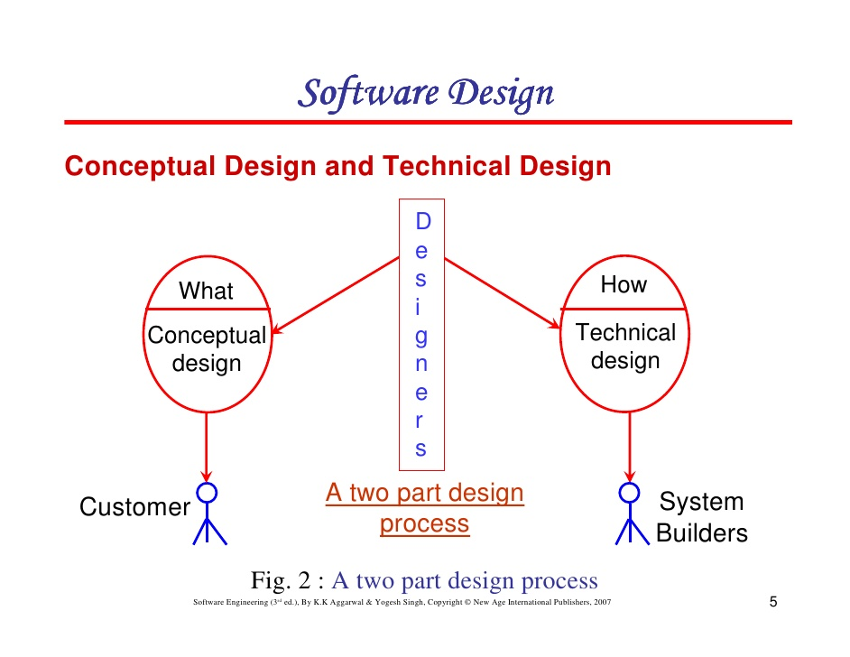

Slide 10
Conceptual design answers..
Where will the data come from
What will happen to data
How will the system look to others.
What choices will be offered to others.
What is the timing of events.
How will the reports and screens look like.

Slide 11
Design Objectives
Goal is to find the best possible design
Have to explore different designs
Evaluation criteria are often subjective and non quantifiable
Major criteria to evaluate a design
  Correctness
  Efficiency
  Maintainability
  Cost

Slide 12
Correctness is the most fundamental
  Does design implement requirements?
  Is design feasible, given the constraints?
Efficiency
  Concerned with the proper use of scarce resources - processor & memory
  Other factors same, efficiency should be maximized

Slide 13
Maintainability
  Most important quality criteria
  Most affected by architectural design
  Should facilitate testing
  Should facilitate discovery and correction of bugs
  Make modifying the system easier
Cost
  For same quality, minimize cost
  Design costs are quite small
  Should try to minimize cost in later phases

Slide 14
Objectives
Design needs to be..
1.Correct & complete.
2.Understandable.
3. At the right level.
4. Maintainable

Slide 15
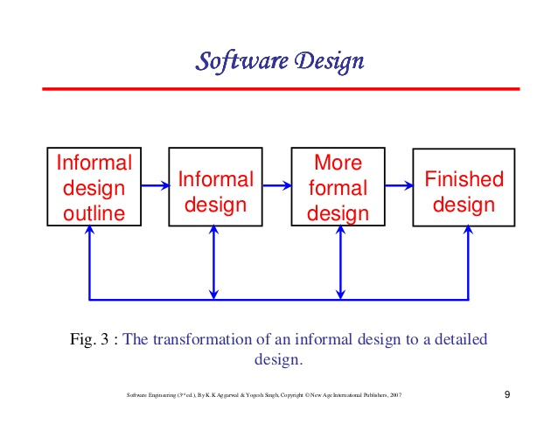
Objectives

Slide 16
Design Principles
Design is a creative process
How to create a design from abstract requirements
There are principles for guiding during design
Two fundamental principles in the design process
  Problem partition
  Abstraction

Slide 17
Problem Partitioning
Basic principle "divide and conquer"
Divide the problem into manageably small pieces
  Each piece can be solved separately
  Each piece can be modified separately
  Pieces can be related to the application
Pieces cannot be independent; they must communicate
Communication adds complexity
As number of components increases, this cost increases
Stop partitioning when cost is more than benefit

Slide 18
Abstraction
Necessary for partitioning
Used in all engg disciplines (all walks of life)
Abstraction of existing components
  Represents components as black boxes
  Hides the details, provide external behavior
  Useful for understanding existing systems
  Necessary for using systems
  Useful for determining design of existing systems

Slide 19
Abstraction during design process
  Components do not exist a priori
  To decide how components interact the designer specifies the external behavior of components
  Allows concentrating on one component at a time
  Permits a component to be considered without worrying about others
  Allows designer to control the complexity
  Permits gradual transition from abstract to concrete
  Necessary for solving parts separately

Slide 20
Functional Abstraction
Employs parameterized subprograms
Specifies the functional behavior of a module
Module is treated as a input/output function
Most languages provide features to support this (e.g. functions, procedures, …)
A functional module can be specified using pre and post conditions

Slide 21
Data Abstraction
An entity in the real world provides some services to the environment it belongs
Similar is the case of data entities
Certain operations are required from a data object
The internals are not of consequence
Data abstraction supports this view
  Data is treated as a set of pre defined operations
  Only operations can be performed on the objects
  Internals are hidden and protected
Modern languages support data abstraction

Slide 22
Modularity
Modularity is the degree to which a system's components may be separated and recombined.
A concept closely tied to abstraction
Modularity supports independence of models
Modules support abstraction in software
Supports hierarchical structuring of programs
Modularity enhances design clarity, eases implementation
Reduces cost of testing, debugging and maintenance
Cannot simply chop a program into modules to get modularly
Need some criteria for decomposition

Slide 23
Modularity
Each module is well defined..
Each module has a well defined purpose.
Modules can be seperately compiled.
Modules can use other modules..
Easier to use & build..
Simpler from outside than from inside…

Slide 24
Coupling
Independent modules: if one can function completely without the presence of other
Independence between modules is desirable
  Modules can be modified separately
  Can be implemented and tested separately
  Programming cost decreases
In a system all modules cannot be independent
Modules must cooperate with each other
More connections between modules
  More dependent they are
  More knowledge about one module is required to understand the other module.
Coupling captures the notion of dependence

Slide 25
Coupling between modules is the strength of interconnections between modules
In general, the more we must know about module A in order to understand module B the more closely connected is A to B
"Highly coupled" modules are joined by strong interconnection
"Loosely coupled" modules have weak interconnections

Slide 26
Goal: modules as loosely coupled as possible
Where possible, have independent modules
Coupling is decided during architectural design
Cannot be reduced during implementation
Coupling is inter-module concept
Major factors influencing coupling
  Type of connection between modules
  Complexity of the interface
  Type of information flow between modules

Slide 27
The complexity and obscurity of interfaces increase coupling
Minimize the number of interfaces per module
Minimize the complexity of each interface
Coupling is minimized if
  Only defined entry of a module is used by others
  Information is passed exclusively through parameters
Coupling increases if
  Indirect and obscure interface are used
  Internals of a module are directly used
  Shared variables employed for communication

Slide 28
Coupling increases with complexity of interfaces (eg. number and complexity of parameters)
Interfaces are needed to support required communication
Often more than needed is used (eg. passing entire record when only a field is needed)
Keep the interface of a module as simple as possible

Slide 29
Coupling depends on type of information flow
Two kinds of information: data or control.
Transfer of control information
  Action of module depends on the information
  Makes modules more difficult to understand
Transfer of data information
  Module can be treated as input-output function

Slide 30
Lowest coupling: interfaces with only data communication
Highest: hybrid interfaces
Coupling | Interface complexity | Type of connection | Type of Communication
Low | Simple, obvious | to module by name | data
High | complicated , obscure | To internal elements | Control or hybrid

Slide 31
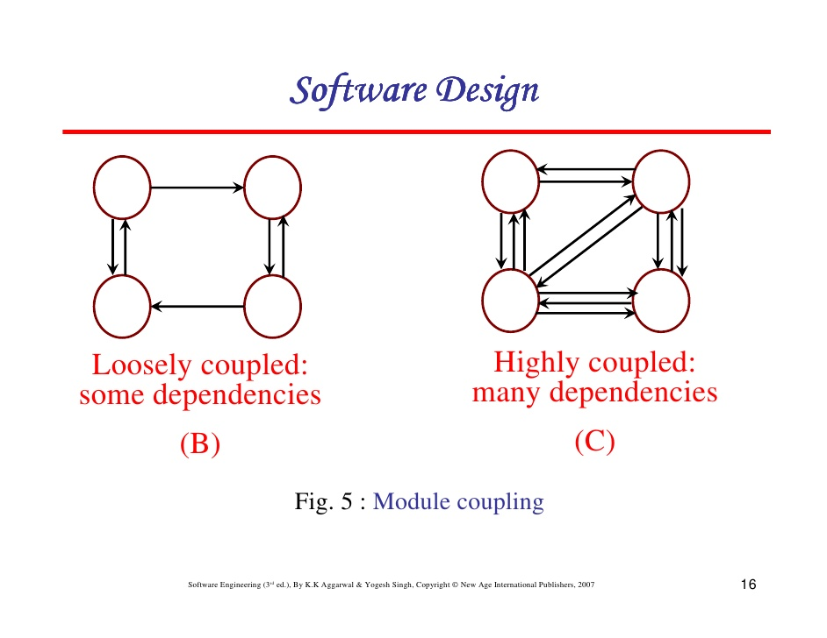
Module coupling..

Slide 32
coupling
Coupling is measured by number of interconnections between modules.
Coupling increases as the number of calls between modules increases..( or shared data Increases)..
Best- is having lowest coupling..
Worst- highest coupling..

Slide 33
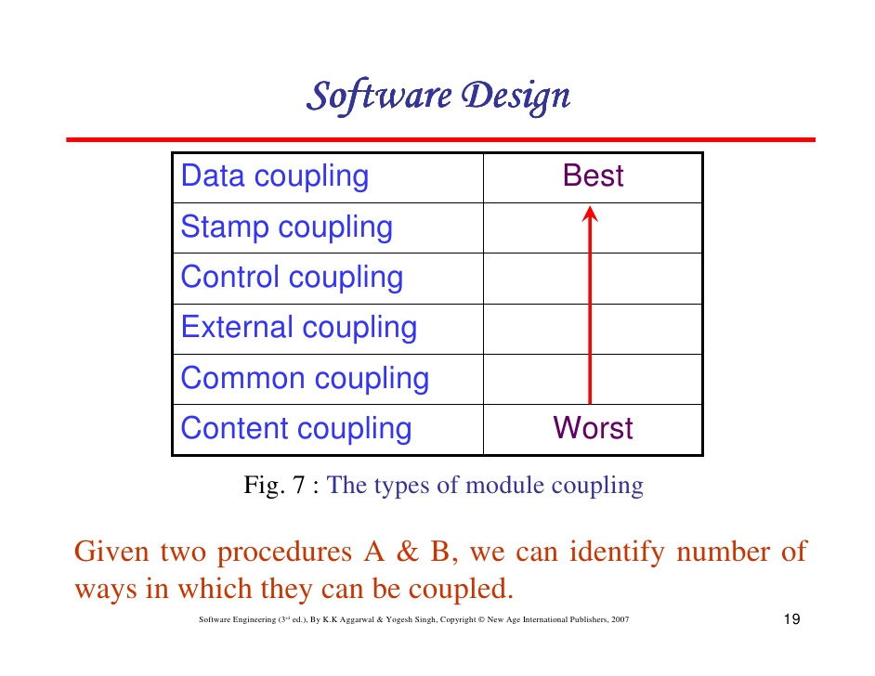
Different types..

Slide 34
Content coupling (high)-
occurs when one module modifies or relies on the internal workings of another module (e.g., accessing local data of another module).
In this situation, a change in the way the second module produces data (location, type, timing) might also require a change in the dependent module.
Common coupling-
also known as global coupling) occurs when two modules share the same global data (e.g., a global variable). Changing the shared resource might imply changing all the modules using it.

Slide 35
External coupling-
External coupling occurs when two modules share an externally imposed data format, communication protocol, or device interface.
This is basically related to the communication to external tools and devices.( like..phone)
Control coupling-
Control coupling is one module controlling the flow of another, by passing it information on what to do (e.g., passing a what-to-do flag).

Slide 36
Stamp coupling (data-structured coupling)-
Stamp coupling occurs when modules share a composite data structure and use only parts of it, possibly different parts
(e.g., passing a whole record to a function that only needs one field of it).
Data coupling-
Data coupling occurs when modules share data through, for example, parameters.
(e.g., passing an integer to a function that computes a square root).

Slide 37
Lowest coupling: interfaces with only data communication
Highest: hybrid interfaces
Coupling | Interface complexity | Type of connection | Type of Communication
Low | Simple, obvious | to module by name | data
High | complicated , obscure | To internal elements | Control or hybrid

Slide 38
Cohesion
Cohesion refers to the degree to which the elements of a module belong together.
Coupling characterized the inter-module bond
Reduced by minimizing relationship between elements of different modules
Another method of achieving this is by maximizing relationship between elements of same module
Cohesion considers this relationship
Interested in determining how closely the elements of a module are related to each other
In practice both are used

Slide 39
Cohesion of a module represents how tightly bound are the elements of the module
Gives a handle about whether the different elements of a module belong together
High cohesion is the goal
Cohesion and coupling are interrelated
Greater cohesion of modules, lower coupling between module
Correlation is not perfect.

Slide 40
Levels of Cohesion
There are many levels of cohesion.
  Coincidental
  Logical – conceptually related procedures are grouped together
  Temporal - aspects of a system are grouped together which are used during the same phase of execution of a program, i.e. execute close together in time
  Communicational - procedures that access the same data are kept together
  Sequential - a series of procedures, where one provides input to the next, are kept together
  Layer - facilities for providing or accessing a set of services through an API or hardware interface are kept together. There must also be a strict hierarchy in which higher level layers can access only lower-level layers. In other words, the system is effectively divided into layers
  Functional - modules which together perform a function (a computation that returns a result and has no side effects) are kept together, and everything else is kept out
Coincidental is lowest, functional is highest
Scale is not linear
Functional is considered very strong

Slide 41
Determining Cohesion
Describe the purpose of a module in a sentence
Perform the following tests
  If the sentence has to be a compound sentence, contains more than one verbs, the module is probably performing more than one function. Probably has sequential or communicational cohesion.
  If the sentence contains words relating to time, like "first", "next", "after", "start" etc., the module probably has sequential or temporal cohesion.

Slide 42
If the predicate of the sentence does not contain a single specific object following the verb, the module is probably logically cohesive. Eg "edit all data", while "edit source data" may have functional cohesion.
Words like "initialize", "clean-up" often imply temporal cohesion.
Functionally cohesive module can always be described by a simple statement

Slide 43
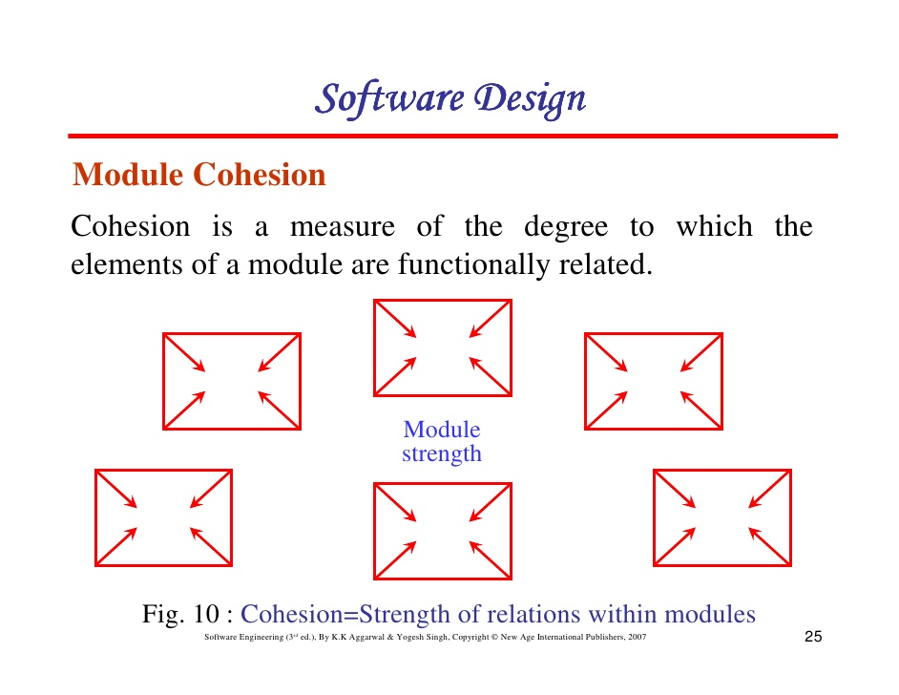
Module Cohesion

Slide 44
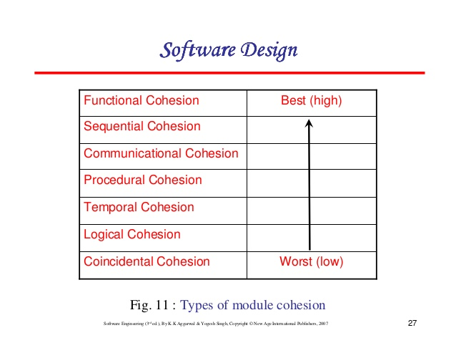

Slide 45
Coincidental cohesion- Worst..
Elements have no relationship.
( a module that selects user’s security classification…also prints employee payroll..)
Logical- logically related funs or data elements are placed in same module.
( one module may read all kinds of input from tape , disk communication port..etc..)

Slide 46
Temporal- A module is used to initialize a set of variables..
A module performs several functions in sequence..
Timely related..
Procedural cohesion - is when parts of a module are grouped because they always follow a certain sequence of execution (e.g. a function which checks file permissions and then opens the file).

Slide 47
Communicational/informational cohesion- Communicational cohesion is when parts of a module are grouped because they operate on the same data (e.g. a module which operates on the same record of information).
Sequential cohesion- Sequential cohesion is when parts of a module are grouped because the output from one part is the input to another part like an assembly line (e.g. a function which reads data from a file and processes the data).

Slide 48
Functional cohesion- Functional cohesion is when parts of a module are grouped because they all contribute to a single well-defined task of the module

Slide 49
Cohesion
Cohesion refers to the degree to which the elements of a module belong together.
Coupling characterized the inter-module bond
Reduced by minimizing relationship between elements of different modules
Another method of achieving this is by maximizing relationship between elements of same module
Cohesion considers this relationship
Interested in determining how closely the elements of a module are related to each other
In practice both are used

Slide 50
Cohesion of a module represents how tightly bound are the elements of the module
Gives a handle about whether the different elements of a module belong together
High cohesion is the goal
Cohesion and coupling are interrelated
Greater cohesion of modules, lower coupling between module
Correlation is not perfect.

Slide 51
Levels of Cohesion
There are many levels of cohesion.
  Coincidental
  Logical – conceptually related procedures are grouped together
  Temporal - aspects of a system are grouped together which are used during the same phase of execution of a program, i.e. execute close together in time
  Communicational - procedures that access the same data are kept together
  Sequential - a series of procedures, where one provides input to the next, are kept together
  Layer - facilities for providing or accessing a set of services through an API or hardware interface are kept together. There must also be a strict hierarchy in which higher level layers can access only lower-level layers. In other words, the system is effectively divided into layers
  Functional - modules which together perform a function (a computation that returns a result and has no side effects) are kept together, and everything else is kept out
Coincidental is lowest, functional is highest
Scale is not linear
Functional is considered very strong

Slide 52
Determining Cohesion
Describe the purpose of a module in a sentence
Perform the following tests
  If the sentence has to be a compound sentence, contains more than one verbs, the module is probably performing more than one function. Probably has sequential or communicational cohesion.
  If the sentence contains words relating to time, like "first", "next", "after", "start" etc., the module probably has sequential or temporal cohesion.

Slide 53
If the predicate of the sentence does not contain a single specific object following the verb, the module is probably logically cohesive. Eg "edit all data", while "edit source data" may have functional cohesion.
Words like "initialize", "clean-up" often imply temporal cohesion.
Functionally cohesive module can always be described by a simple statement

Slide 54
Top-Down vs Bottom-up Design
Top down design
Starts with the system specifications
Defines a module to implement the specs
Specifies subordinate modules
Then treats each specified module as the problem
Refinement proceeds till bottom level modules reached
At each stage a clear picture of design exists
Most natural for handling complex problems
Have been propagated by many
Many design methodologies based on this
Feasibility is not know till the end

Slide 55
Bottom up Design
In we start by designing bottom modules
Building blocks Layers or abstraction or virtual machines
Necessary if existing modules have to be reused
Pure top-down or bottom-up is not possible
In bottom-up must have some idea of the top
Often a combination is used

Slide 56
Strategy Of Design/ Bottom up Design:
The bottom up design model starts with most specific and basic components.
Proceeds to higher level with lower level of components.
With each higher level, the amount of abstraction is increased.
Design is progressed fro bottom layer to upwards.( Botto m –up).

Slide 57
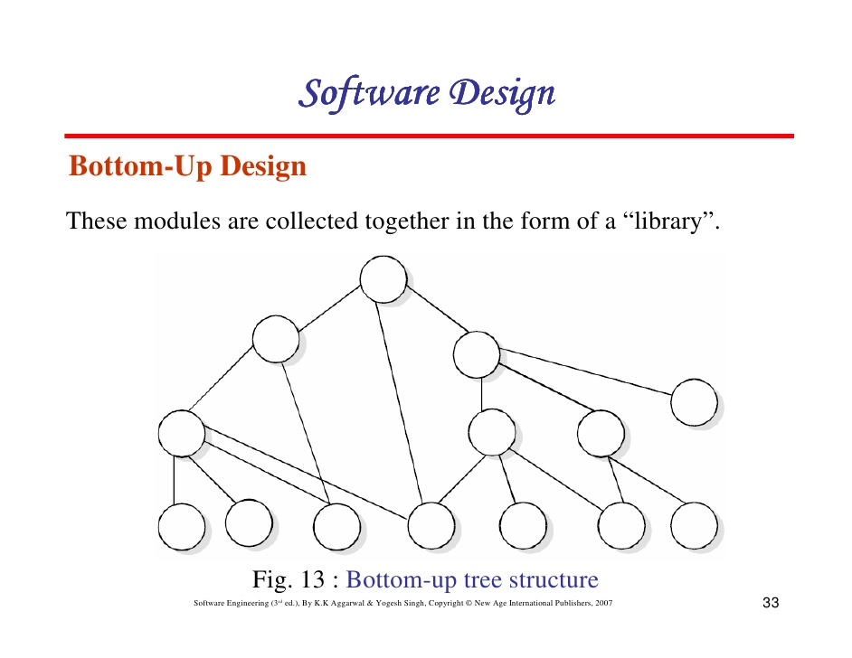

Slide 58
Weakness-
Need to use a lot of intuition to decide what functionality a module should provide.
Strength.
If a system is to be built from existing system this methods is useful as it starts from some existing modules.

Slide 59
Top Down Design Approach:
Top-down design takes the whole software system as one entity
Then decomposes it to achieve more than one sub-system or component based on some characteristics.
Each sub-system or component is then treated as a system and decomposed further.
This process keeps on running until the lowest level of system in the top-down hierarchy is achieved.
Top-down design starts with a generalized model of system and keeps on defining the more specific part of it.
Top-down design is more suitable when the software solution needs to be designed from scratch and specific details are unknown.

Slide 60
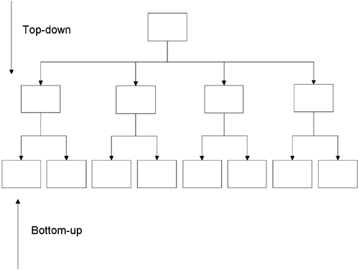

Slide 61
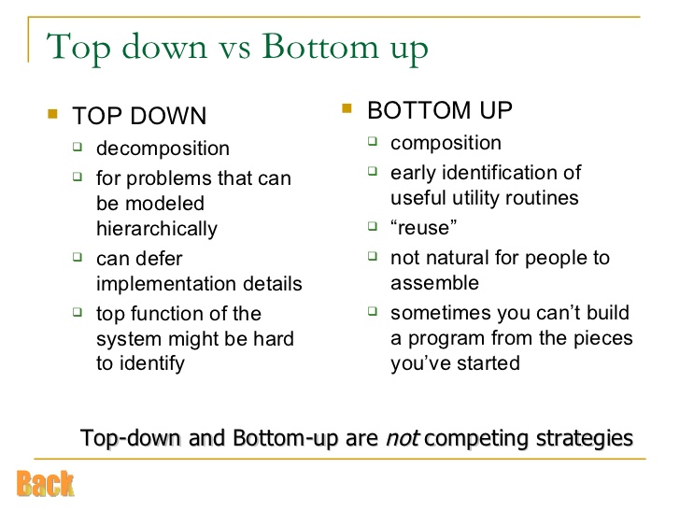

Slide 62
Function-oriented design
In function-oriented design, the system is comprised of many smaller sub-systems known as functions.
These functions are capable of performing significant task in the system.
The system is considered as top view of all functions.
Divide and conquer methodology is used.
This design mechanism divides the whole system into smaller functions.

Slide 63
Provides means of abstraction by concealing the information and their operation
Characteristic of functions is that when a program calls a function, the function changes the state of the program

Slide 64
Function-oriented design conceals the details of an algorithm in a function but system state information is not hidden.

Slide 65
The design Process.
The whole system is seen as how data flows in the system by means of data flow diagram.
DFD depicts how functions changes data and state of entire system.
The entire system is logically broken down into smaller units known as functions on the basis of their operation in the system.
Each function is then described at large.

